Slide 1
June 3, 2020
Flex2020 Task Force
Office of Public Instruction Staff
Location: Zoom Meeting

Slide 2
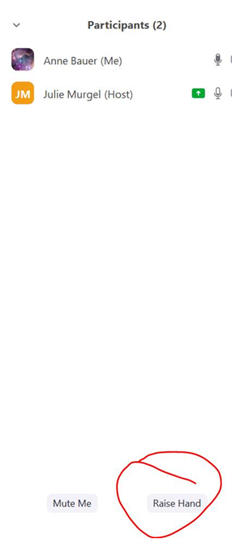
Task Force Member Participation
OPI encourages the task force members to participate in discussion:
Raise Your Hand
  Participants>Raise Hand
Identify Yourself in the Chat (Full Name)
Comment in the Chat

Slide 3
Zoom Meeting Rules
This meeting will be recorded.
Conducted virtually due to social distancing guidelines currently in effect in Montana.
When speaking, please identify yourself and speak clearly.
You may be asked to repeat your comments or questions if there is a delay or issue with the audio.

Slide 4
Session 2 Outcomes
To discuss findings and considerations on focus group essential questions.
To identify flexibilities needed for each focus area.
To outline next steps and off-line work prior to the third session.

Slide 5
Agenda
Welcome (5min)
Review of Task Force Purpose, Process, and Key Deliverables (5min)
Focus group work time (20min)
Group Share-Out (10min)
Focus group work time (15min)
Next Steps (5min)

Slide 6
Welcome

Slide 7
Flex2020 Task Force Purpose
Why have we been pulled together? What is the overall purpose?
To focus on flexibilities that promote opportunities for student success.
To clarify and communicate existing policy flexibility.
To consider potential waivers in key policy areas to enhance learning experiences as our schools prepare for the Fall of 2020.
Notes:
Notes: The current state and federal policy environment was built to service a more traditional school model. The COVID-19 pandemic has highlighted the various forms of friction between what educators need to enable and empower continuity of learning and what policy encourages or allows. Flexibilities provide relief from state and federal policies and regulations that put-up barriers. Flexibilities allow students to keep on learning and educators to rethink and transform education, drive meaningful change, build capacity, and support student health and well-being.

Slide 8
Key Deliverables
What are the critical documents or outputs that the Task Force must create to meet its charge?
At the end of the 3 sessions, each of the 5 focus groups will provide a list of recommended flexibilities to the Superintendent of Public Instruction for immediate consideration.

Slide 9
Flex2020 Task Force
Process and Timeline
What is our process?
Host 3- one hour sessions: 5/20, 6/3, and 6/10
Break-out into 5 focus area groups:
  Strengthening Existing policy flexibility
  Evaluating progress and impact of state graduation, credit, funding, licensure, and accreditation policies
  Maximizing flexibilities in assessment, accountability and reporting systems
  Fostering and supporting local innovation
  Leveraging Federal Flexibilities and Resources
Between meetings, task force members will research, gather input, and reflect on questions for identified focus areas.
Collaborate on recommended flexibilities for the Superintendent of Public Instruction for immediate consideration and rapid response.
Who is responsible for doing what? What are our resources and constraints?
What are the key activities that must be done to address the issues, create the deliverables, and meet the charge?
A proposed list of steps is presented to use as a starting point for the task force.

Slide 10
Communication Plan
Posted on the OPI Webpage under FLEX 2020 Task Force Tab will be:
  Meeting Minutes and Recording Links
  Agendas
  Materials: Presentations and Resource Tools
  Focus Group Deliverables
Task Force Members will be emailed meeting minutes and the recording links.

Slide 11
Operating Logistics
The Schedule: When? Where?
  Meeting Dates: May 20, June 3, June 10
  Meeting Times: 11:00 a.m. – Noon
Task Force members are expected to attend all three sessions and actively participate.
Focus groups will determine deliverables through a consensus process.
Each focus group has a note taker to capture groups questions and decisions.

Slide 12
Meetings Norms
Focus on what matters
Contribute your thinking
Speak your mind and heart
Listen to understand
Link and connect ideas
Listen together for insights and deeper questions.

Slide 13
Break-out Rooms
You will be placed in pre-set Zoom Break-Out Rooms:
  A box will appear on your screen to join the break-out group. Press “join.”
  At the 19 minute mark—a 60 second warning will appear that the session will be ending.
  At 20 minutes, you will automatically rejoin the whole group.

Slide 14
Focus Group Work Time
Debrief focus-group essential questions and brainstorm
20 minutes

Slide 15
Whole-group share out
Share-out highlights from each group discussion (2 mins)
  Strengthening Existing policy flexibility
  Evaluating progress and impact of state graduation, credit, funding, licensure, and accreditation policies
  Maximizing flexibilities in assessment, accountability and reporting systems
  Fostering and supporting local innovation
  Leveraging Federal Flexibilities and Resources
What main ideas and opportunities did your group identify?

Slide 16
Focus Group work time
What flexibilities are needed? (15 minutes)
Potential Legislative Policy
Funding Needs
Regulation Updates
Waiver Considerations

Slide 17
Next Steps
1. Draft action steps to enact these flexibilities and make them useable:
• What do we need to do?
• Who needs to be involved to enact the flexibilities?
• How long will it take to implement the flexibility?
• What are the stakeholder requirements?
• What resources would be needed?
• What are the risks involved in enacting the flexibility?
• What are the implications on student success?
The Session 3 pre-work form with uploaded focus group flexibilities will be sent to task force members within 24 hrs.
2. Be prepared to prioritize and build consensus on the focus group recommended flexibilities at Session #3: June 10th at 11:00

Slide 18

Thank you!
For questions or additional information please contact Julie Murgel at Julie.Murgel@mt.gov
Notes:
Are there any questions from this presentation?

